Slide 1
CSCI 631 Foundations of Computer Vision
Ifeoma Nwogu
ion@cs.rit.edu
Lecture –Deep Object Detection

Slide 2
Schedule
Last class
RNN
Today
Object Detection Architectures

Slide 3
Developments in object detection
PASCAL VOC
Before deep convnets
Using deep convnets
Notes:
We’re in the midst of an object detection renaissance and it’s brought about by the successful application of deep convnets to the problem.

Slide 4
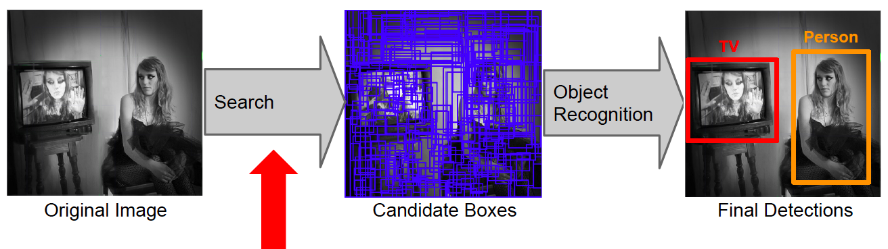
Beyond sliding windows: Region proposals
Advantages:
Cuts down on number of regions detector must evaluate
Allows detector to use more powerful features and classifiers
Uses low-level perceptual organization cues
Proposal mechanism can be category-independent
Proposal mechanism can be trained

Slide 5
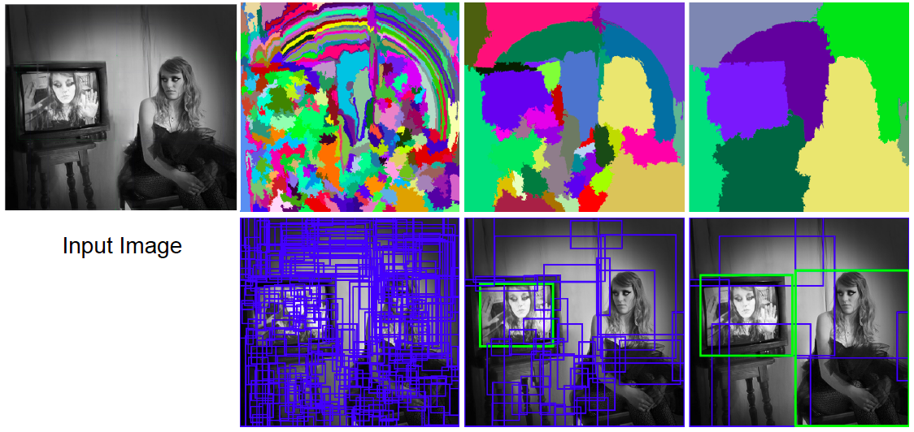
Selective search: Basic idea
Use hierarchical segmentation: start with small superpixels and merge based on diverse cues
J. Uijlings, K. van de Sande, T. Gevers, and A. Smeulders, Selective Search for Object Recognition, IJCV 2013

Slide 6
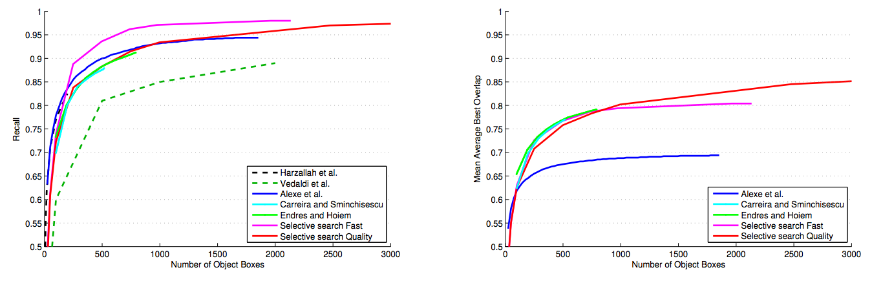
Evaluation of region proposals
J. Uijlings, K. van de Sande, T. Gevers, and A. Smeulders, Selective Search for Object Recognition, IJCV 2013

Slide 7
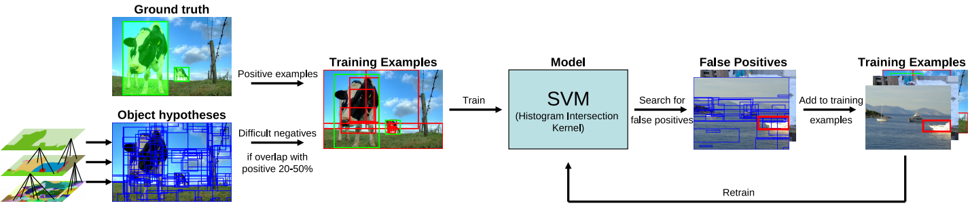
Selective search detection pipeline
Feature extraction: color SIFT, codebook of size 4K, spatial pyramid with four levels = 360K dimensions
J. Uijlings, K. van de Sande, T. Gevers, and A. Smeulders, Selective Search for Object Recognition, IJCV 2013

Slide 8
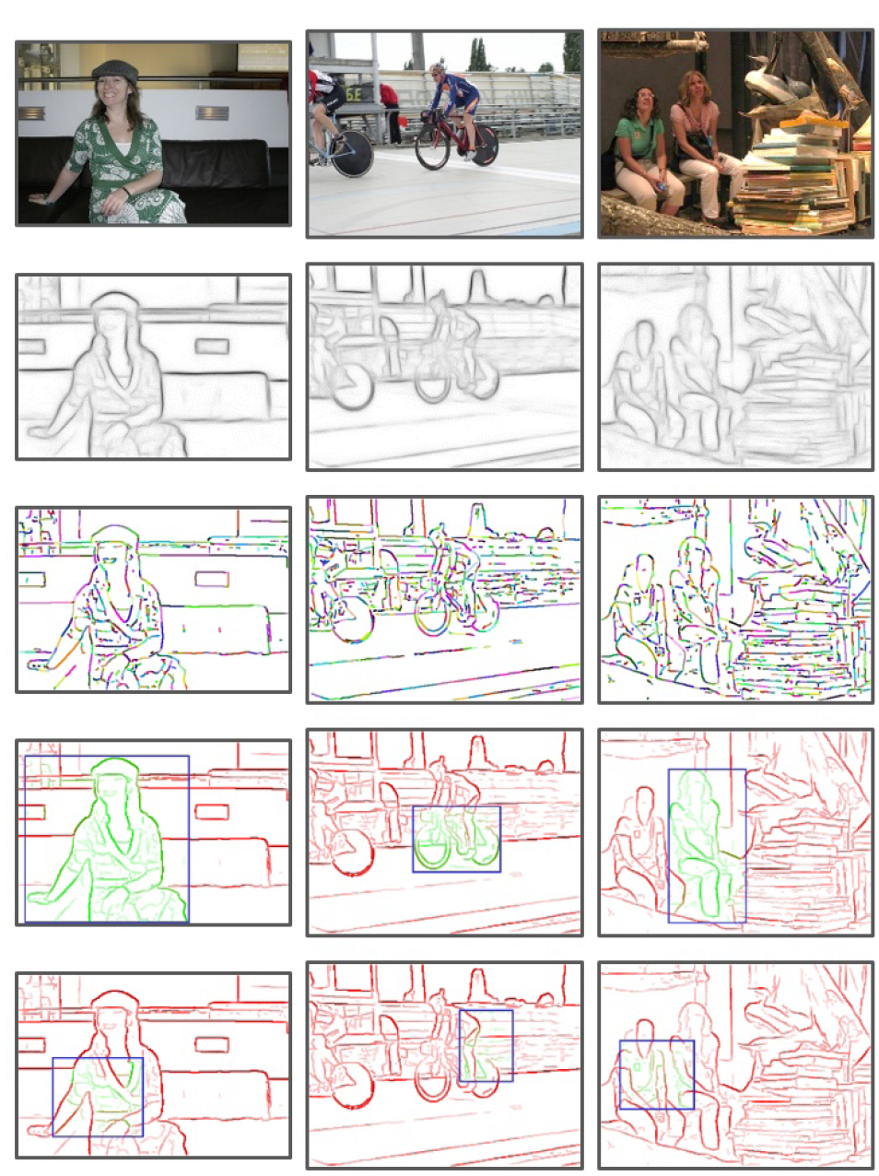
Proposal method 2: EdgeBoxes
Box score: number of edges in the box minus number of edges that overlap the box boundary
Uses a trained edge detector
Uses efficient data structures for fast evaluation
Gets 75% recall with 800 boxes (vs. 1400 for Selective Search), is 40 times faster
C. Zitnick and P. Dollar, Edge Boxes: Locating Object Proposals from Edges, ECCV 2014.

Slide 9
R-CNN: Region proposals + CNN features
Source: R. Girshick
SVMs
Classify regions with SVMs
SVMs
ConvNet
SVMs
ConvNet
Forward each region through ConvNet
ConvNet
Warped image regions
Region proposals
Input image
R. Girshick, J. Donahue, T. Darrell, and J. Malik, Rich Feature Hierarchies for Accurate Object Detection and Semantic Segmentation, CVPR 2014.
Notes:
The features are also sent to a linear regressor that improves object localization.
The components outlined in purple are “post hoc” in the sense that they are learned after the convnet weights are trained and forever frozen.

Slide 10
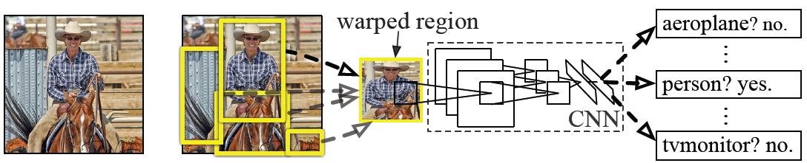
R-CNN details
Regions: ~2000 Selective Search proposals
Network: AlexNet pre-trained on ImageNet (1000 classes), fine-tuned on PASCAL (21 classes)
Final detector: warp proposal regions, extract fc7 network activations (4096 dimensions), classify with linear SVM
Bounding box regression to refine box locations
Performance: mAP of 53.7% on PASCAL 2010 (vs. 35.1% for Selective Search and 33.4% for DPM).
R. Girshick, J. Donahue, T. Darrell, and J. Malik, Rich Feature Hierarchies for Accurate Object Detection and Semantic Segmentation, CVPR 2014.
Notes:
Object detection system overview. Our system (1) takes an input image, (2) extracts around 2000 bottom-up region proposals, (3) computes features for each proposal using a large convolutional neural network (CNN), and then (4) classifies each region using class-specific linear SVMs. R-CNN achieves a mean average precision (mAP) of 53.7% on PASCAL VOC 2010. For comparison, Uijlings et al. (2013) report 35.1% mAP using the same region proposals, but with a spatial pyramid and bag-of-visual-words approach. The popular deformable part models perform at 33.4%.

Slide 11
R-CNN pros and cons
Pros
Accurate!
Any deep architecture can immediately be “plugged in”
Cons
Ad hoc training objectives
Pre-train network with softmax classifier (log loss)
Train post-hoc linear SVMs (hinge loss)
Train post-hoc bounding-box regressions (least squares)
Training is slow (84h), takes a lot of disk space
2000 convnet passes per image
Inference (detection) is slow (47s / image with VGG16)

Slide 12
Fast R-CNN
Softmax classifier
Linear +
softmax
Linear
Bounding-box regressors
FCs
Fully-connected layers
“RoI Pooling” layer
Region proposals
“conv5” feature map of image
ConvNet
Forward whole image through ConvNet
Source: R. Girshick
R. Girshick, Fast R-CNN, ICCV 2015
Notes:
Rather than using post-hoc bounding-box regressors, bounding-box regression is implemented as an additional linear layer in the network

Slide 13
Fast R-CNN training
Log loss + smooth L1 loss
Multi-task loss
Linear +
softmax
Linear
FCs
Trainable
ConvNet
Source: R. Girshick
R. Girshick, Fast R-CNN, ICCV 2015
Notes:
Rather than using post-hoc bounding-box regressors, bounding-box regression is implemented as an additional linear layer in the network

Slide 14
Fast R-CNN results
 | Fast R-CNN | R-CNN
Train time (h) | 9.5 | 84
- Speedup | 8.8x | 1x
Test time / image | 0.32s | 47.0s
Test speedup | 146x | 1x
mAP | 66.9% | 66.0%
Timings exclude object proposal time, which is equal for all methods.
All methods use VGG16 from Simonyan and Zisserman.
Source: R. Girshick
Notes:
These speed improvements do not sacrifice object detection accuracy. In fact, mean average precision is better than the baseline methods due to our improved training.

Slide 15
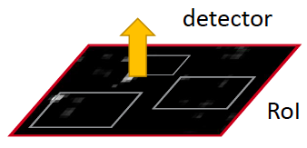
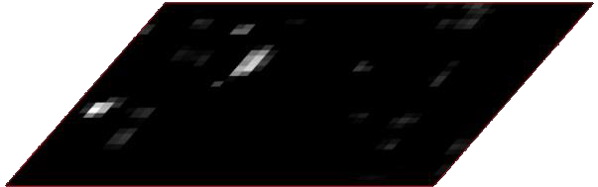
Faster R-CNN
Region proposals
Region Proposal Network
feature map
feature map
CNN
CNN
share features
S. Ren, K. He, R. Girshick, and J. Sun, Faster R-CNN: Towards Real-Time Object Detection with Region Proposal Networks, NIPS 2015

Slide 16
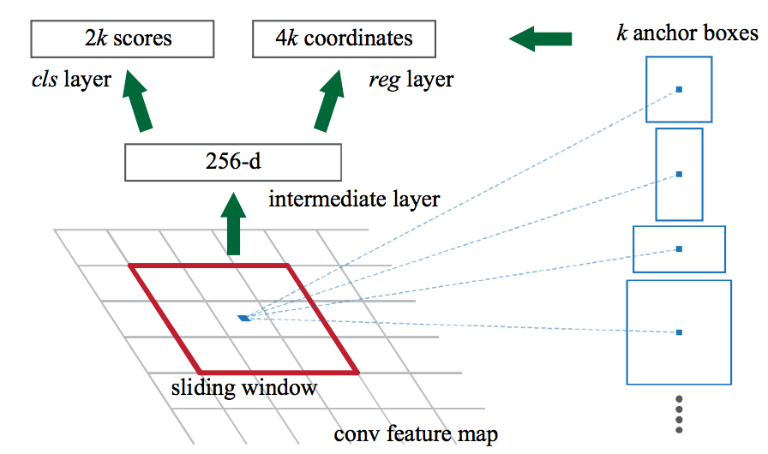
Region proposal network
Slide a small window over the conv5 layer
Predict object/no object
Regress bounding box coordinates
Box regression is with reference to anchors (3 scales x 3 aspect ratios)

Slide 17
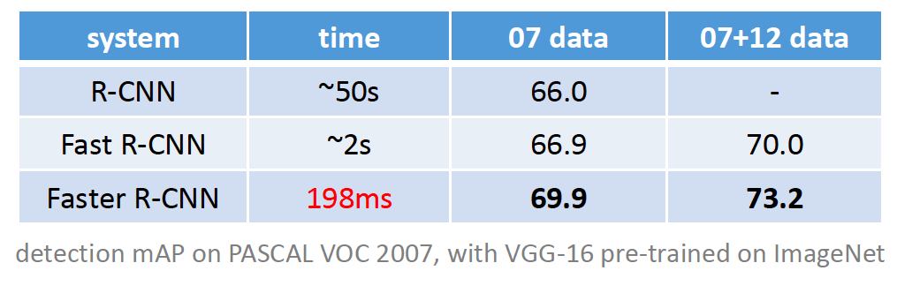
Faster R-CNN results

Slide 18
Object detection progress
Faster R-CNN
Fast R-CNN
Before deep convnets
R-CNNv1
Using deep convnets

Slide 19

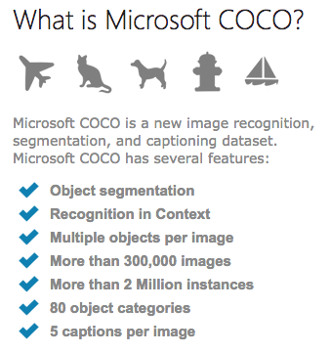
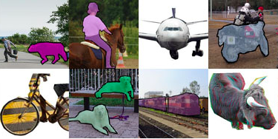
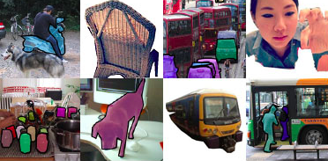
Next trends
New datasets: MSCOCO
80 categories instead of PASCAL’s 20
Current best mAP: 37%
http://mscoco.org/home/

Slide 20
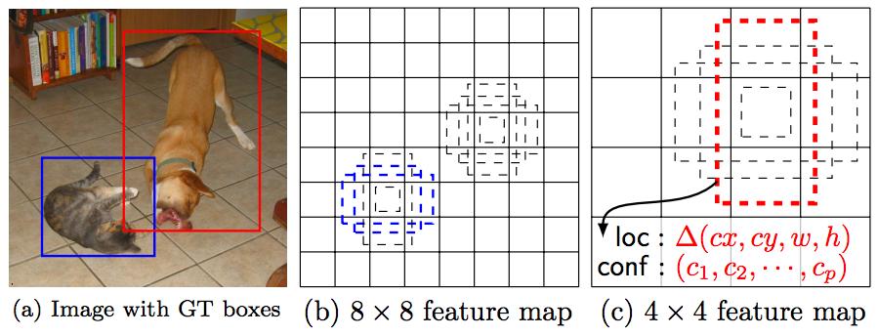
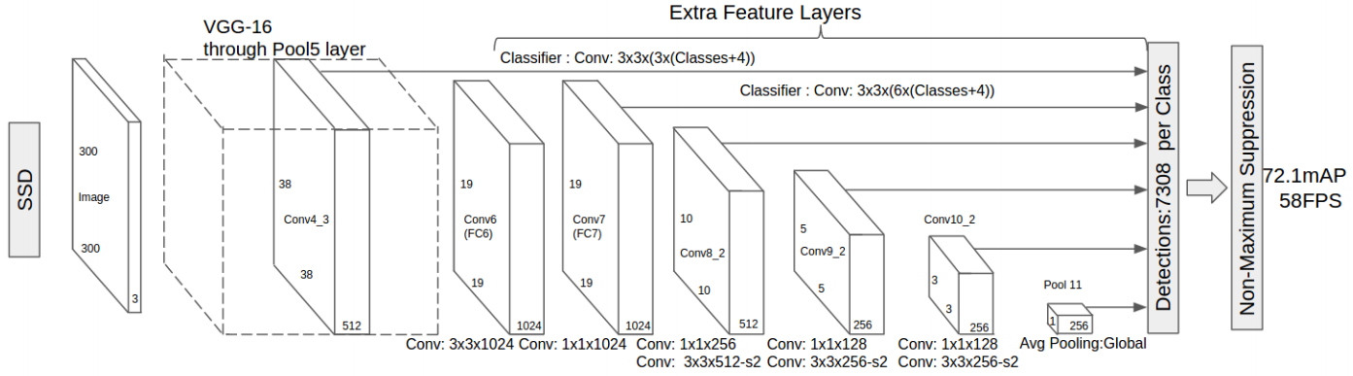
Next trends
Fully convolutional detection networks
W. Liu, D. Anguelov, D. Erhan, C. Szegedy, S. Reed, C.-Y. Fu, and A. Berg, SSD: Single Shot MultiBox Detector, arXiv 2016.

Slide 21
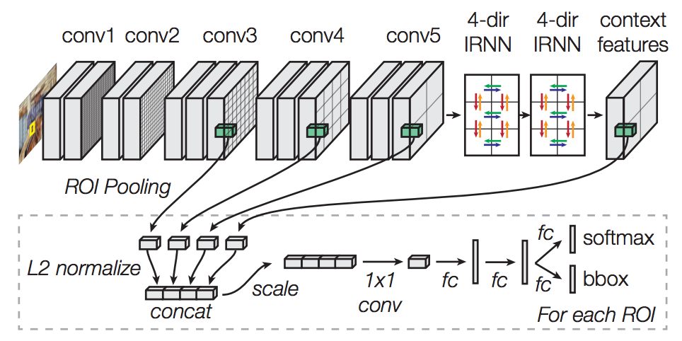
Next trends
Networks with context
S. Bell, L. Zitnick, K. Bala, and R. Girshick, Inside-Outside Net: Detecting Objects in Context with Skip Pooling and Recurrent Neural Networks, arXiv 2015.

Slide 22
Review: R-CNN
SVMs
Classify regions with SVMs
SVMs
ConvNet
SVMs
ConvNet
Forward each region through ConvNet
ConvNet
Warped image regions
Region proposals
Input image
R. Girshick, J. Donahue, T. Darrell, and J. Malik, Rich Feature Hierarchies for Accurate Object Detection and Semantic Segmentation, CVPR 2014.
Notes:
The features are also sent to a linear regressor that improves object localization.
The components outlined in purple are “post hoc” in the sense that they are learned after the convnet weights are trained and forever frozen.

Slide 23
Review: Fast R-CNN
Softmax classifier
Linear +
softmax
Linear
Bounding-box regressors
FCs
Fully-connected layers
“RoI Pooling” layer
Region proposals
“conv5” feature map of image
ConvNet
Forward whole image through ConvNet
R. Girshick, Fast R-CNN, ICCV 2015
Notes:
Rather than using post-hoc bounding-box regressors, bounding-box regression is implemented as an additional linear layer in the network

Slide 24
Review: Faster R-CNN
Region proposals
Region Proposal Network
feature map
feature map
CNN
CNN
share features
S. Ren, K. He, R. Girshick, and J. Sun, Faster R-CNN: Towards Real-Time Object Detection with Region Proposal Networks, NIPS 2015

Slide 25
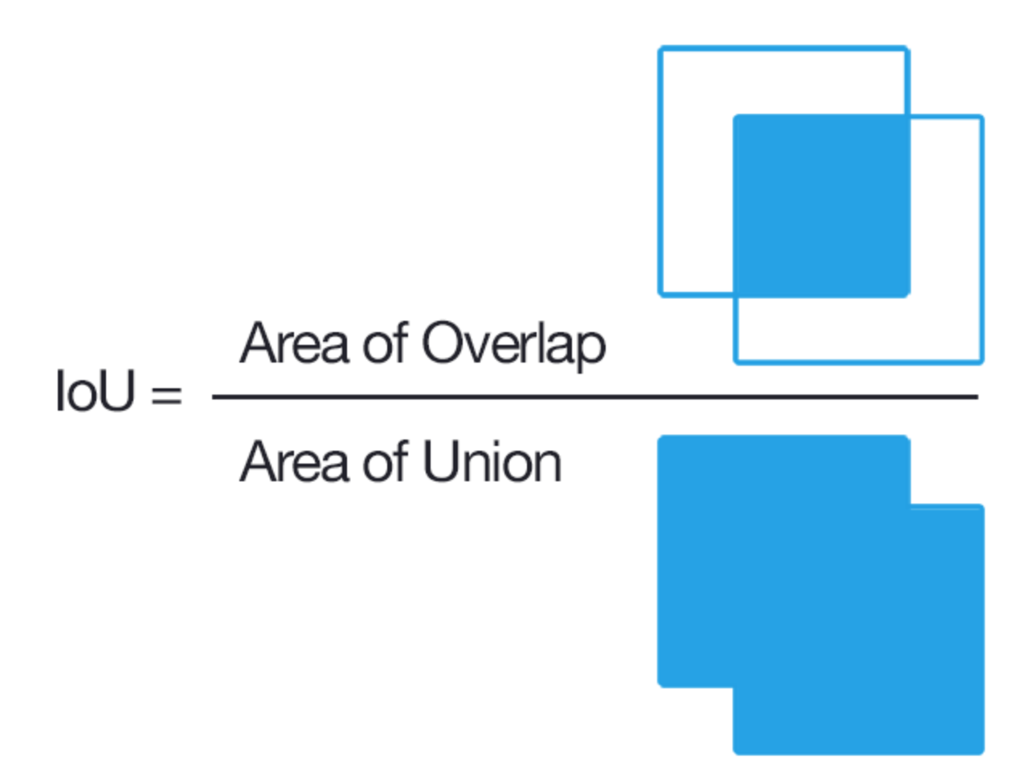
Intersection over Union (IoU)

Slide 26
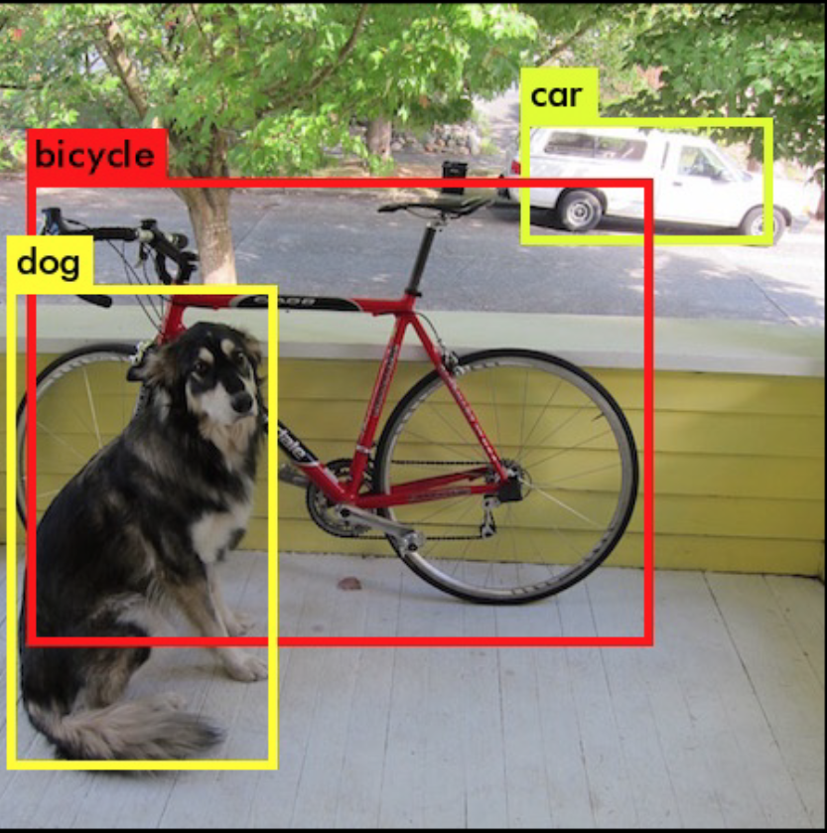
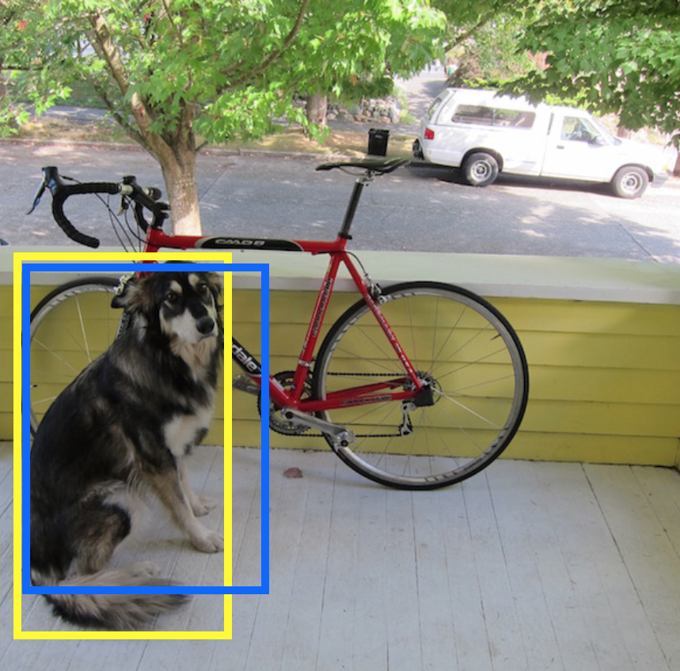
TP: IoU > 0.5

Slide 27
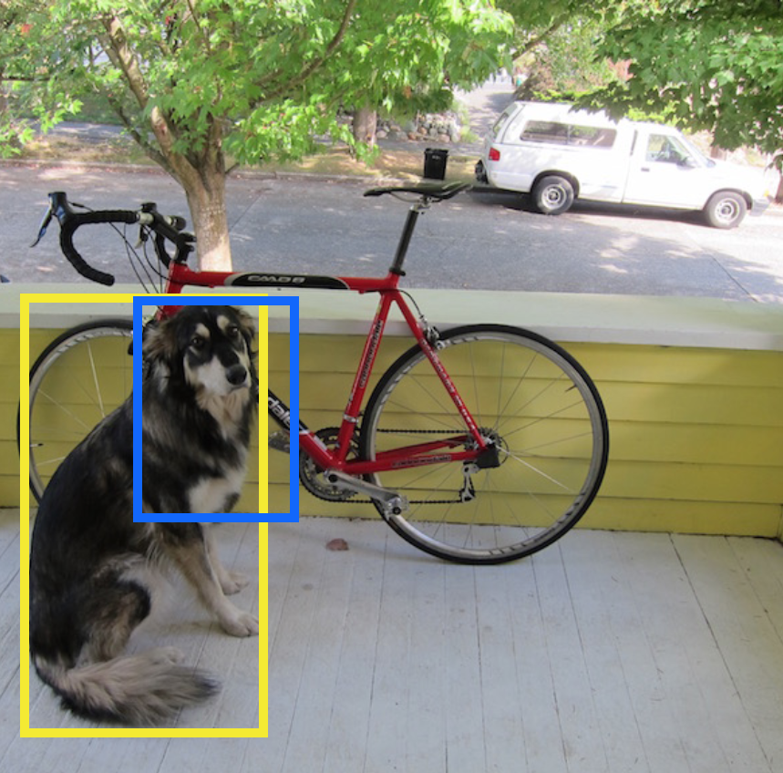
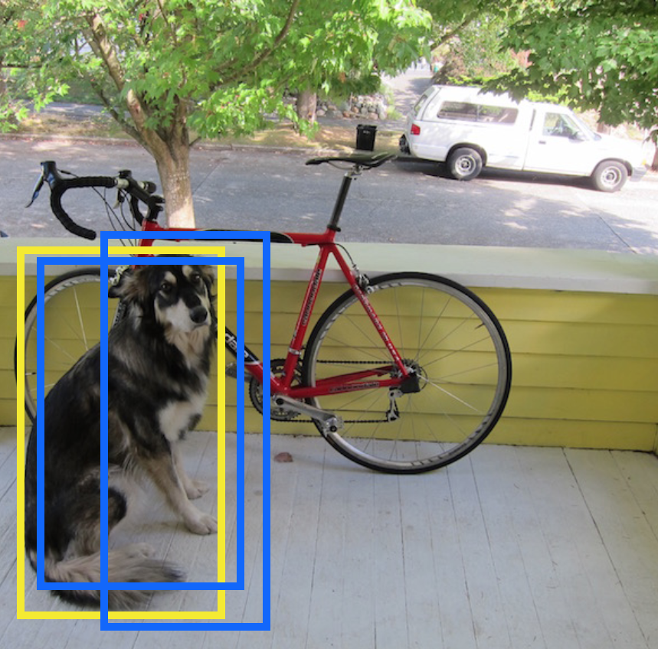
FP: IoU < 0.5 or duplicate BB

Slide 28
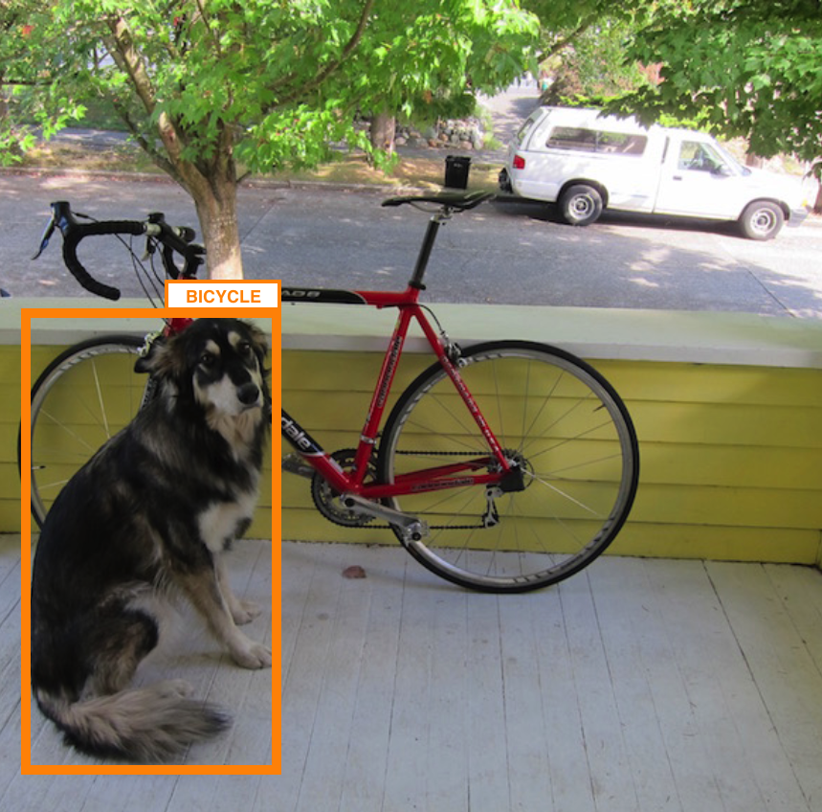
FN: Wrong classification

Slide 29
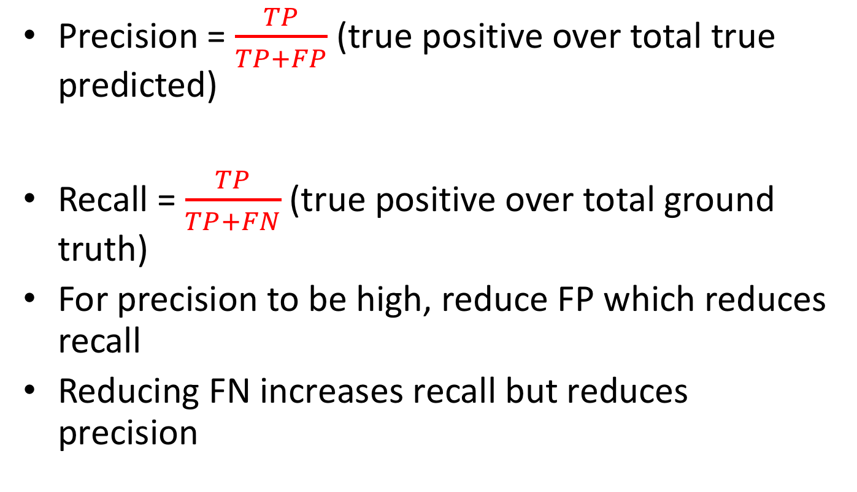
Precision-Recall Curve
Precision = $\frac{TP}{TP+FP}$ (true positive over total true predicted)
Recall = $\frac{TP}{TP+FN}$ (true positive over total ground truth)
For precision to be high, reduce FP which reduces recall
Reducing FN increases recall but reduces precision

Slide 30
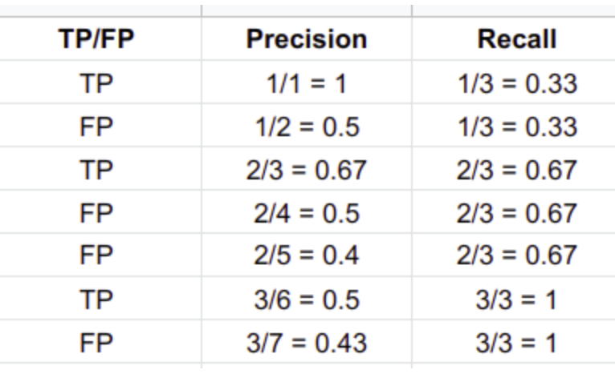
Precision-Recall Computation (1 class)
Now take the entire test set and run your object detector
Sort the detections (BB) according to the confidence score of the Softmax classifier
1st image has highest confidence, etc

Slide 31
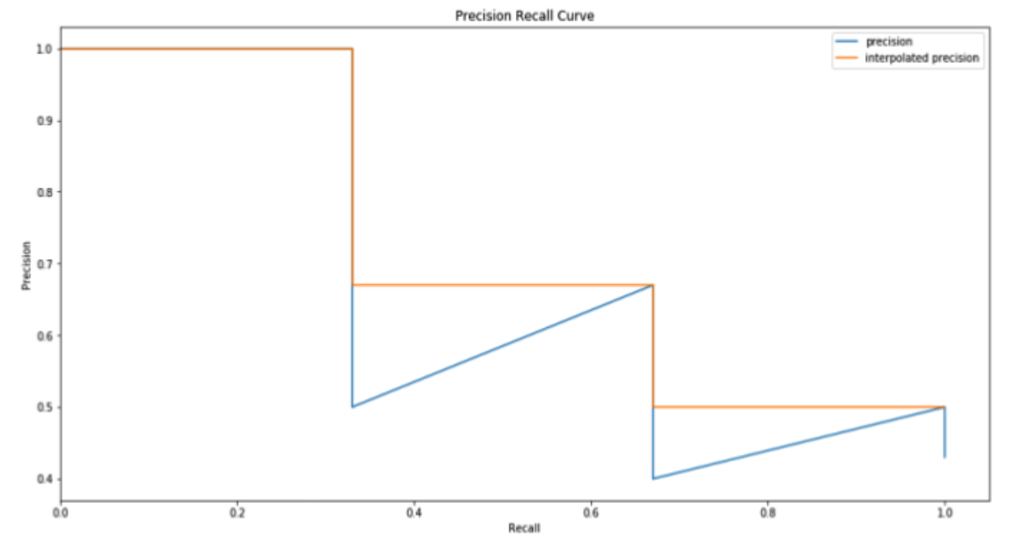
Generate the PR-curve
Smooth out the curve
Calculate AP by taking AUC
11 point intervals (0 to 1.0) from PASCAL VOC
Replace with max precision to the right of recall p(r)

Slide 32
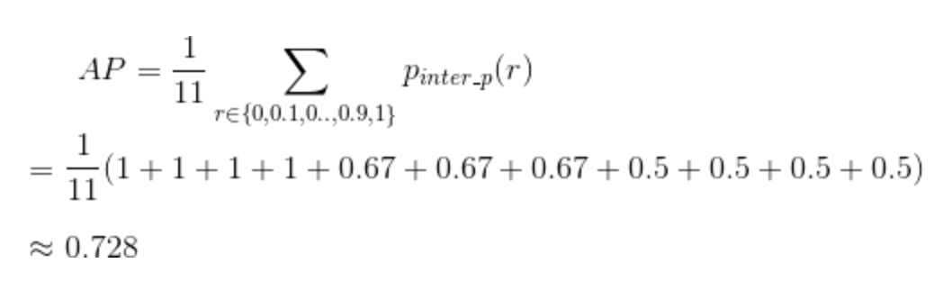
mAP Calculation
The mAP for object detection is the average of the AP calculated for all the classes.

Slide 33

Questions

